Slide 1
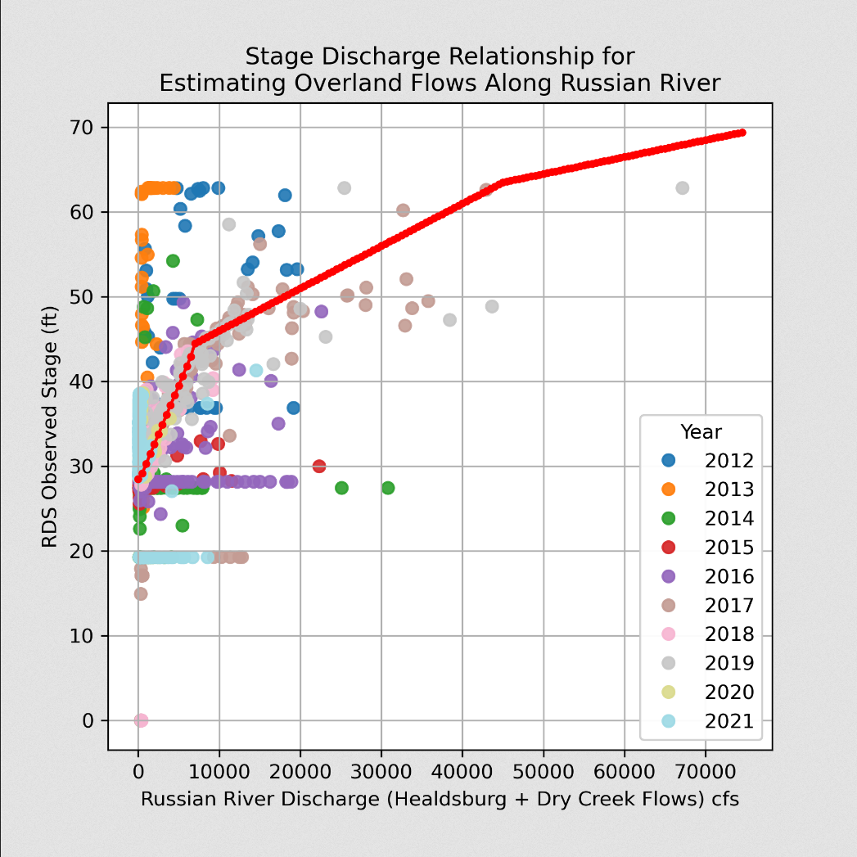
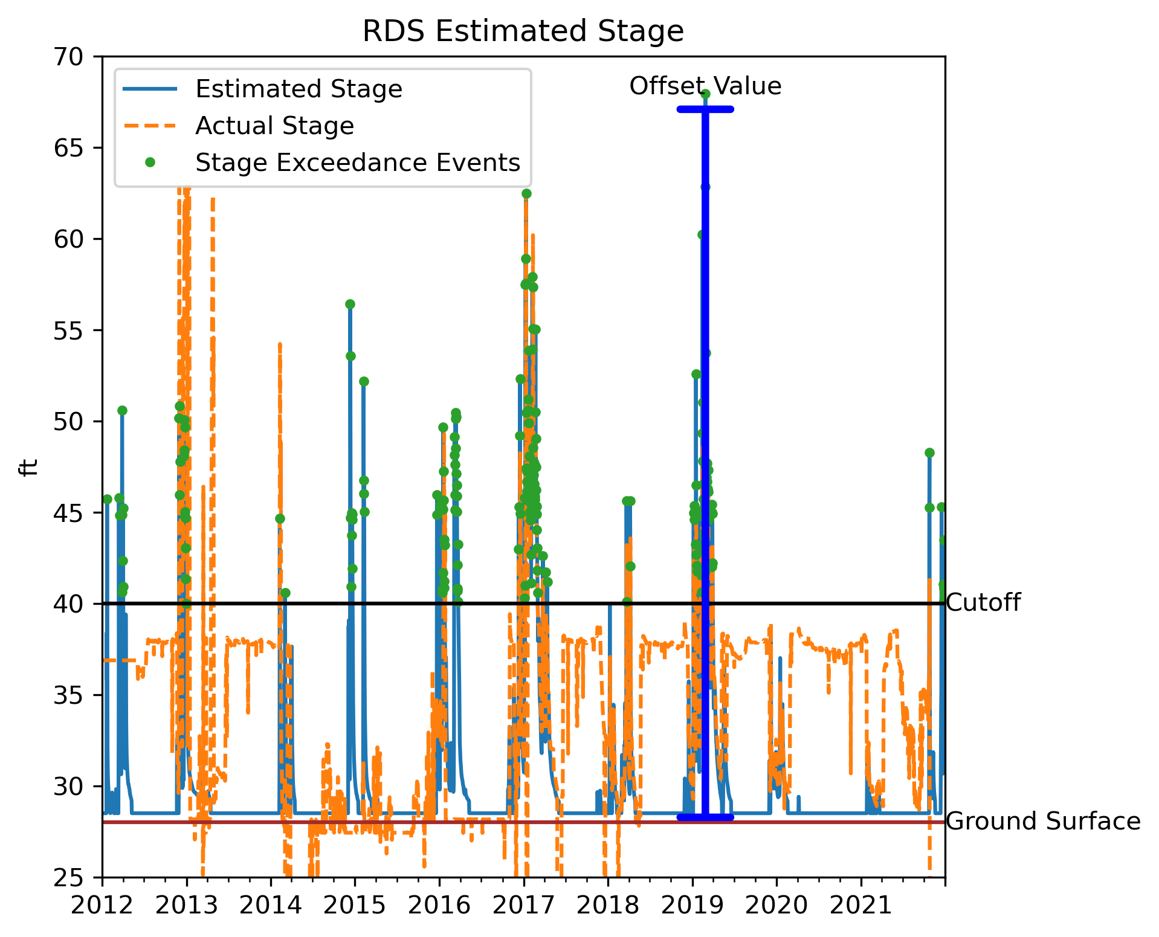
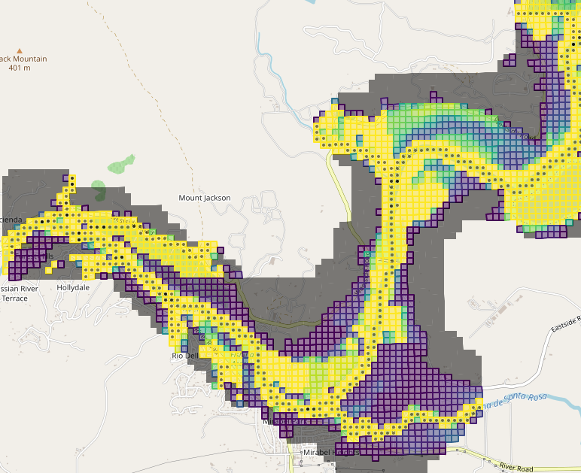
Estimating Overland Flow Events
Step 1: Create stage – discharge curve from observed stage and Russian River flows
Step 2: Calculate ‘offset value’ for timeseries. Apply this time-varying value to every streamflow cell. Add the offset to streambed elevation. That is the WSE for the river.
Step 3: Map timeseries of WSE to model cells. When WSE>GSE recharge is applied.

